Slide 1
BITS Pilani
Prof.Aruna Malapati
Asst Professor
Department of CSIS

Slide 2
Dependency Parsing

Slide 3
Today’s Agenda
Dependency Parsing
Dependency Relations
Projective vs Non-projective parsers
Transition based Dependency Parser
Neural Network based Dependency Parser

Slide 4
Dependency Parsing
Dependency parsing tries to parse the structure of a sentence.
What is the relationship of the words in a sentence?
Analyzing the words in a sentence is important to understand the meaning of the sentence.
Dependence parsing is the task of extracting a dependency parse of a sentence that represents its grammatical structure and defines the relationships between “head” words, which modify those heads.

Slide 5
Applications of Dependency Parsing
Named Entity Recognition
Noun Phrase Co-resolution
Entity Linking
Machine Translation

Slide 6
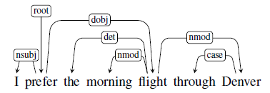
Dependency grammars
Dependency grammars depict the syntactic structure of sentences solely in terms of the words in a sentence and an associated set of directed head-dependent grammatical relations that hold among these words.

Slide 7
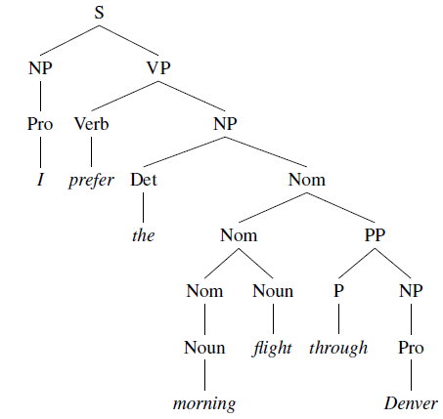
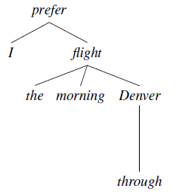
Example
Dependency – based
Constituent– based

Slide 8
Advantage of dependency grammars
Directly encode information
Deal with languages that have a relatively free word order.
Dependency relations approximate semantic relationships between words and arguments, which is useful for many applications
  coreference resolution
  question answering
  information extraction.

Slide 9
Dependency Formalism
The dependency structures are directed graphs.
G = (V, A)
where V is a set of vertices and A is a set of ordered pairs of vertices (or directed arcs). Each arc points from the head to a dependent
Head Dependent
Directed arcs can also be labeled with the grammatical relation that holds between the head and a dependent.

Slide 10
Dependency Trees
The dependency structure must be connected, have a designated root node, and be acyclic.
These result in a rooted tree called a dependency tree.
A dependency tree is a digraph where:
  1. There is a single designated root node that has no incoming arcs
  2. Each vertex has exactly one incoming arc (except the root node)
  3. There is a unique path from the root node to each vertex in V
This mean that each word in the sentence has exactly one head.

Slide 11
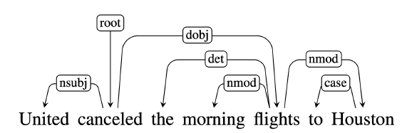
Dependency Relations
Labeled with the type of grammatical function involved between the words.
• nsubj and dobj identify the subject and direct object of the verb cancelled
• nmod, det and case relations denote modifiers of the nouns flights and Houston.

Slide 12
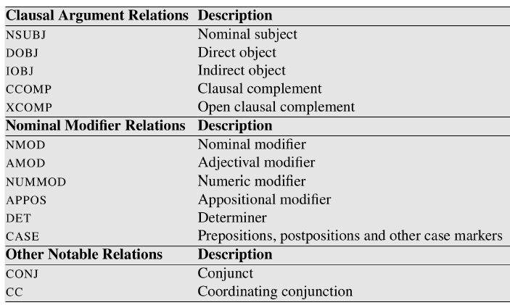
Dependency Relations

Slide 13
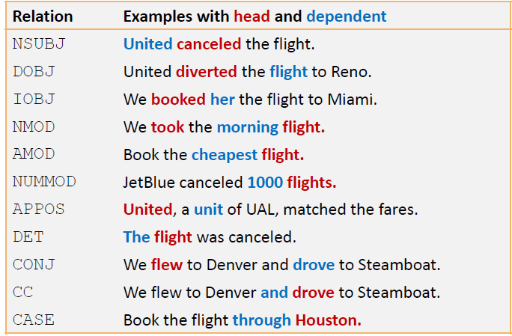
Dependency Relations

Slide 14
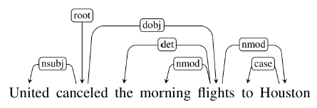
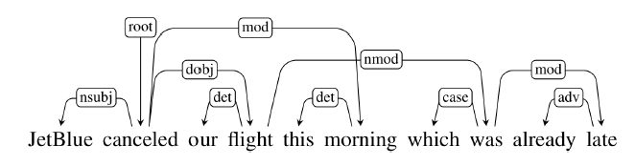
Projective vs Non-projective

Slide 15
Dependency Treebanks
1. Having human annotators build dependency structures directly
2. Using an automatic parser and then employing human annotators to correct the output
3. Automatically transforming phrase-structure treebanks into dependency structure treebanks

Slide 16
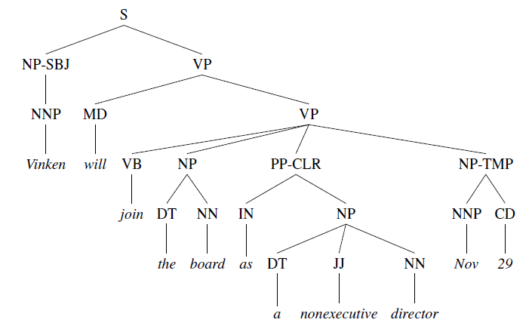
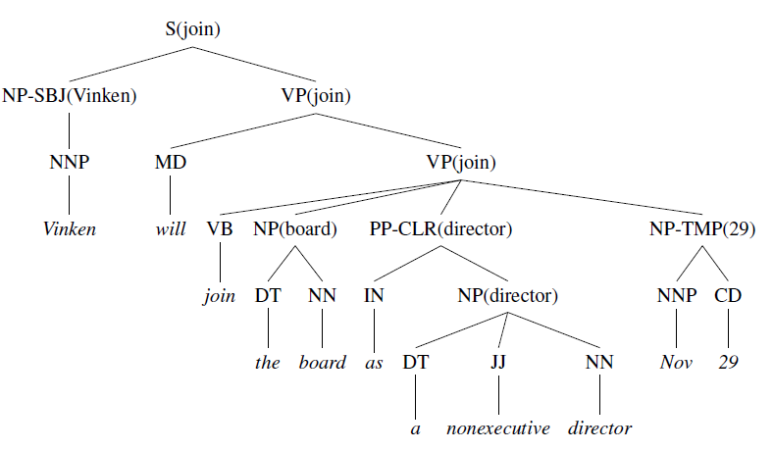
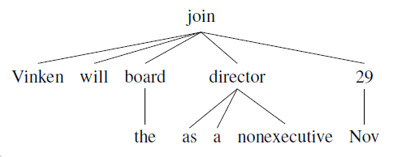
Example

Slide 17
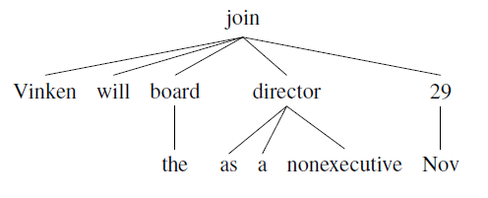
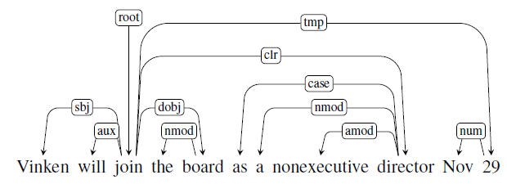
Example(contd…)

Slide 18
Parsing Methods
Two approaches for implementing dependency parsers
Transition-Based : projective trees
Graph-Based : handle non-projectivity
Notes:
There are two main approaches used in dependency parsers:
1. Transition-Based
2. Graph-Based
Transition-based approaches can only produce projective trees.
Therefore any sentences with non-projective structures will contain
errors.
In contrast, graph-based parsing approaches can handle non-projectivity
but are more computationally expensive.

Slide 19
Transition-based Parsing
Greedy stack-based algorithm using a Shift Reduce parser.
The configuration of the SR parser has a stack, Input Buffer of words and Dependency relations.
Parsing consists of a sequence of “shift-reduce” transitions. Once all the words have been moved off the stack, they have each and been assigned a head (and an appropriate relation).
The resulting configuration is a dependency tree.

Slide 20
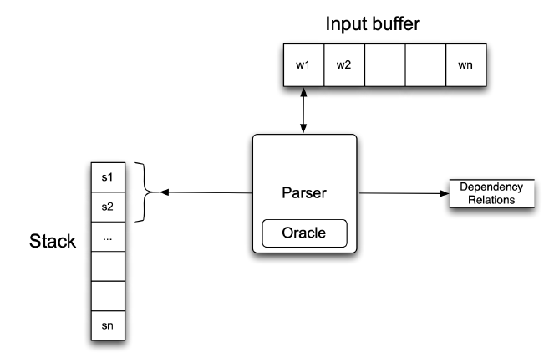
Transition-based Parser
The parser examines the top two elements of the stack and selects an action based on consulting an oracle that examines the current configuration.

Slide 21
Transition-based Parser
Intuition: create a dependency tree by examining the words in a single pass over the input, moving from left to right:
Assign the current word as the head of some previously seen word,
Assign some previously seen word as the head of the current word,
Or postpone doing anything with the current word, adding it to the stack so that it can be processed later.

Slide 22
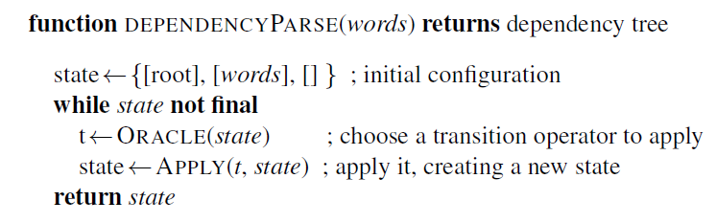
Transition-based Parser

Slide 23
Operators
There are three transition operators that will operate on the top two elements of the stack:
LEFTARC: Assert a head-dependent relation between the word at the top of the stack and the word directly beneath it; remove the lower word from the stack.
2. RIGHTARC: Assert a head-dependent relation between the second word on the stack and the word at the top; remove the word at the top of the stack;
3. SHIFT: Remove the word from the front of the input buffer and push it onto the stack.

Slide 24
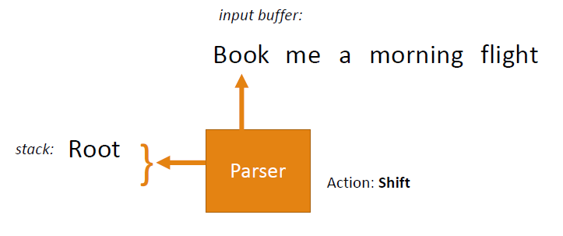
Example
Root Book me a morning flight

Slide 25
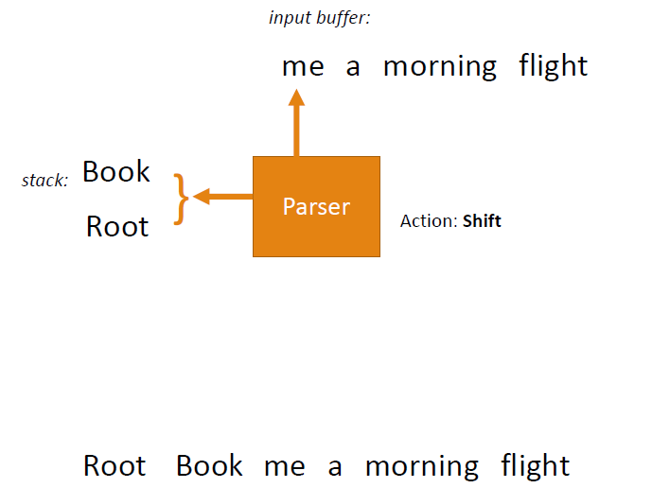
Example (Contd..)

Slide 26
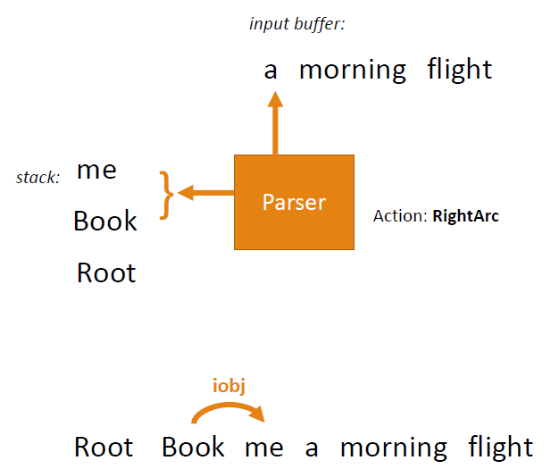
Example (Contd..)

Slide 27
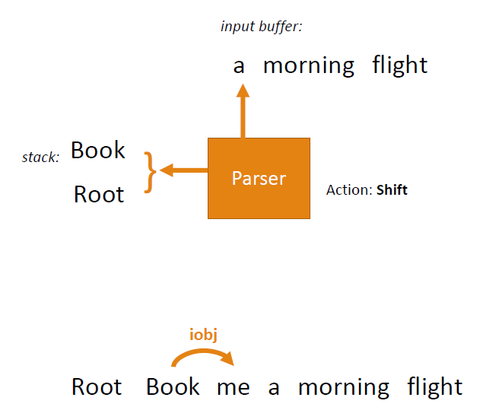
Example (Contd..)

Slide 28
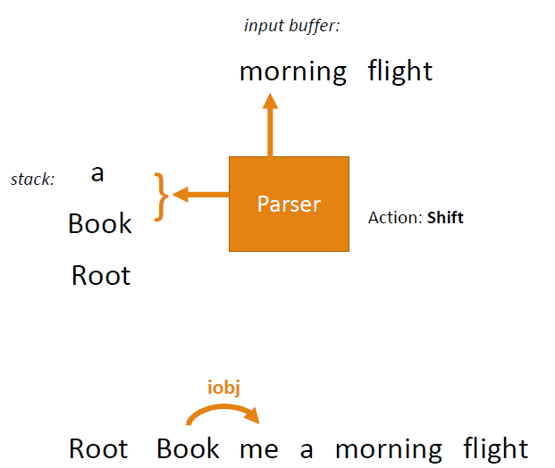
Example (Contd..)

Slide 29
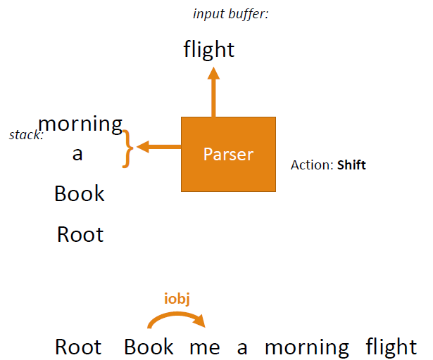
Example (Contd..)

Slide 30
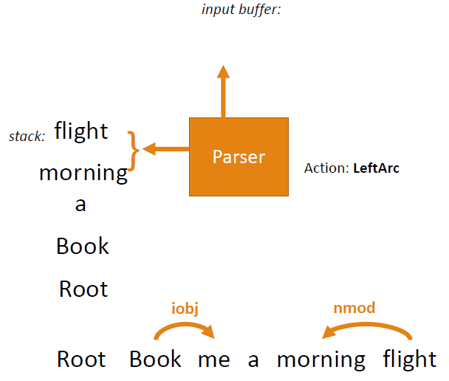
Example (Contd..)

Slide 31
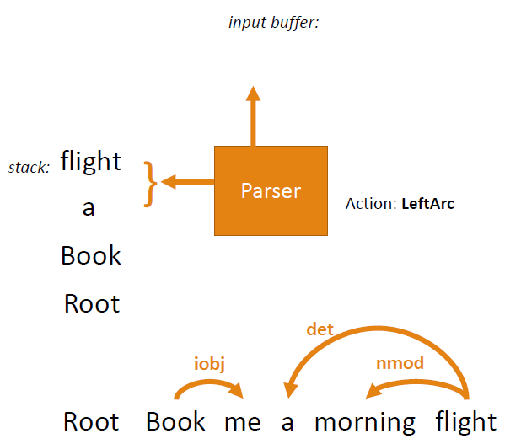
Example (Contd..)

Slide 32
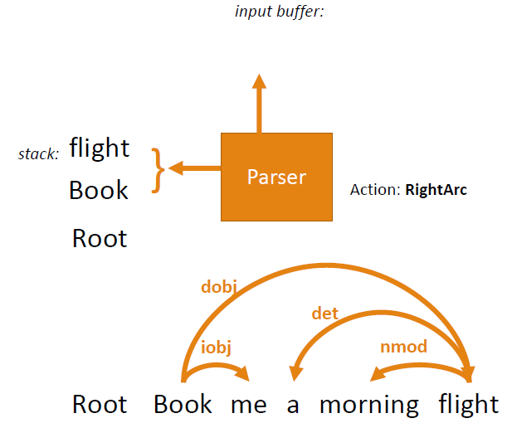
Example (Contd..)

Slide 33
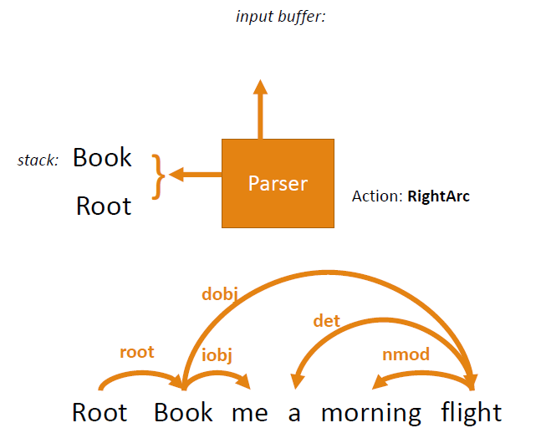
Example (Contd..)

Slide 34
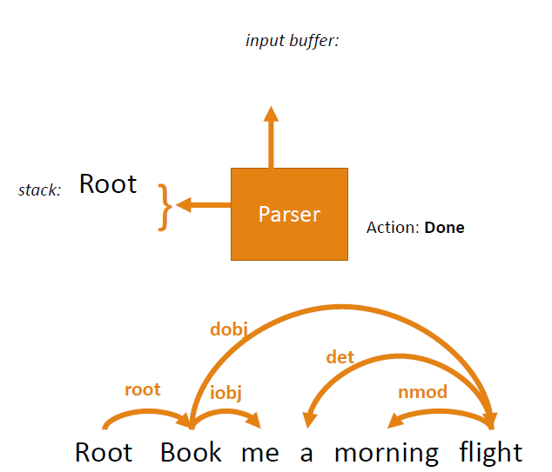
Example (Contd..)

Slide 35
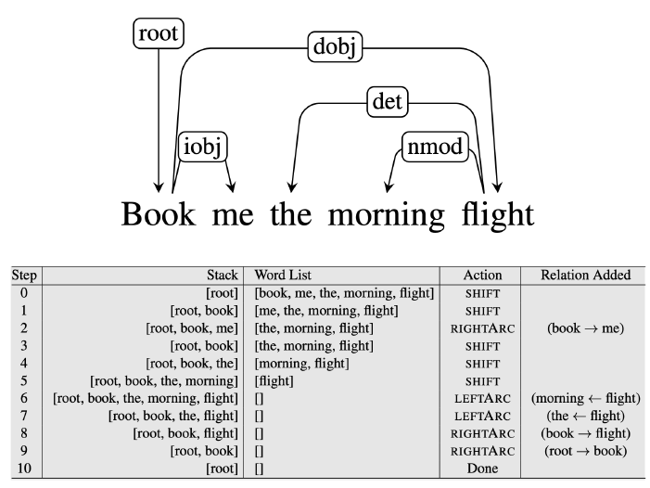
Example

Slide 36
Creating an Oracle
Transition based systems use supervised Machine Learning algorithms to train classifiers that play the role of the Oracle.
Given appropriate training data, these methods learn a function that maps from configurations to transition operators.
The source for the training data will be existing dependency trees.

Slide 37
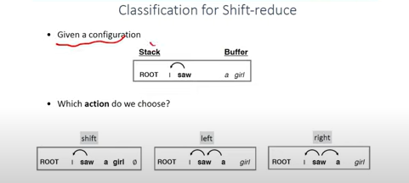
Generating Training Data
The oracle takes as input a configuration and returns as output a transition operator.
Open questions
  Where do we get training examples?
  What are good features for this task?

Slide 38
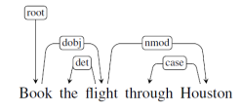
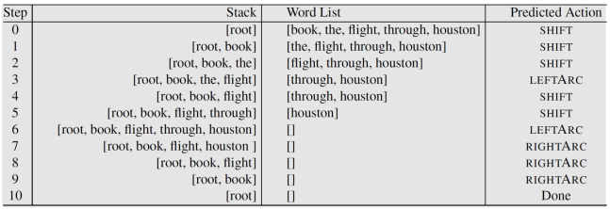
Classification of actions
• What we have in a treebank
• What we need to train an oracle
• Pairs of configurations and predicted parsing action

Slide 39
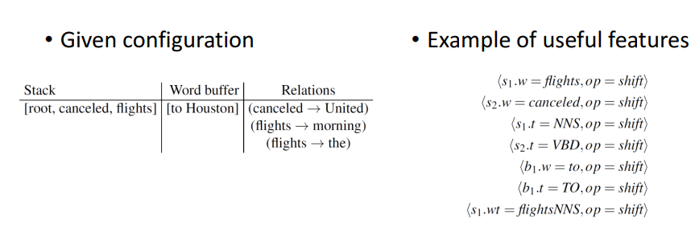
Feature template

Slide 40
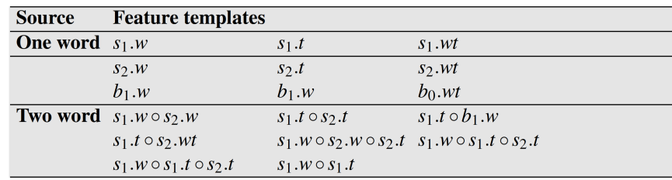
Features example

Slide 41
Stanford Neural Dependency Parser
Train a neural net to choose the best shift-reduce parser action to take at each step.
Uses features (words, POS tags, arc labels) extracted from the current stack, buffer, and arcs as context.

Slide 42
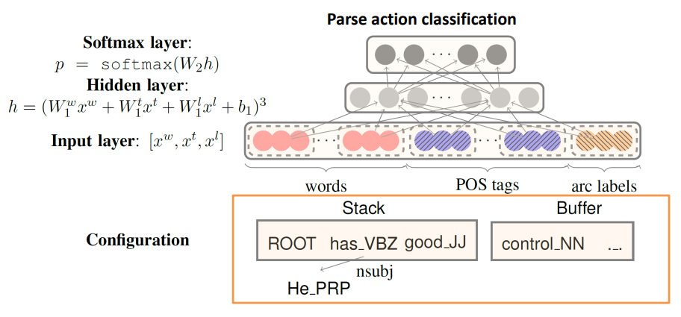
Neural Architecture

Slide 43
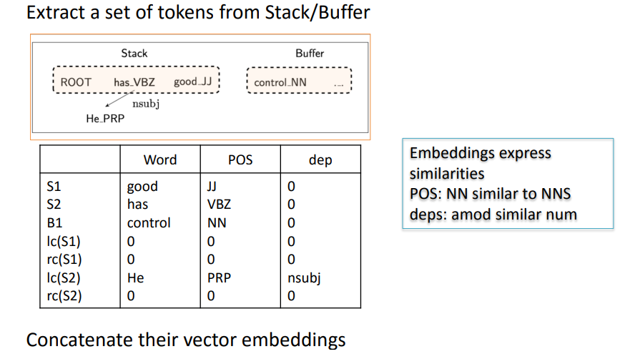
State Representation

Slide 44
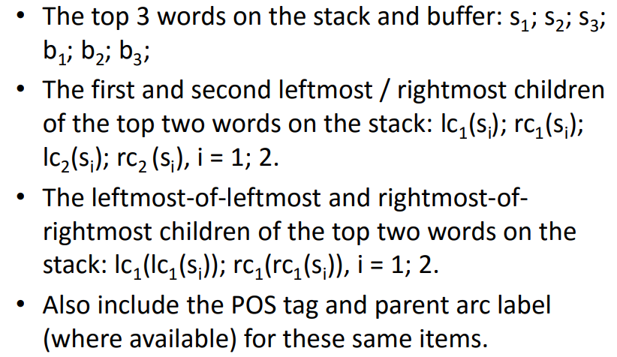
Context Features Used

Slide 45
Input Embeddings
• Instead of using one-hot input encodings, words and POS tags are “embedded” in a 50 dimensional set of input features.
• Embedding POS tags is unusual since there are relatively few; however, it allows similar tags (e.g. NN and NNS) to have similar embeddings and thereby behave similarly.

Slide 46
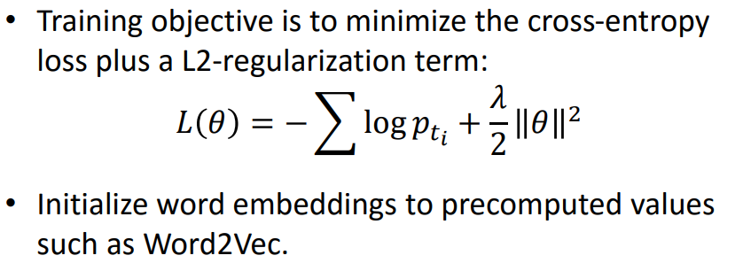
Training Algorithm

